Slide 1
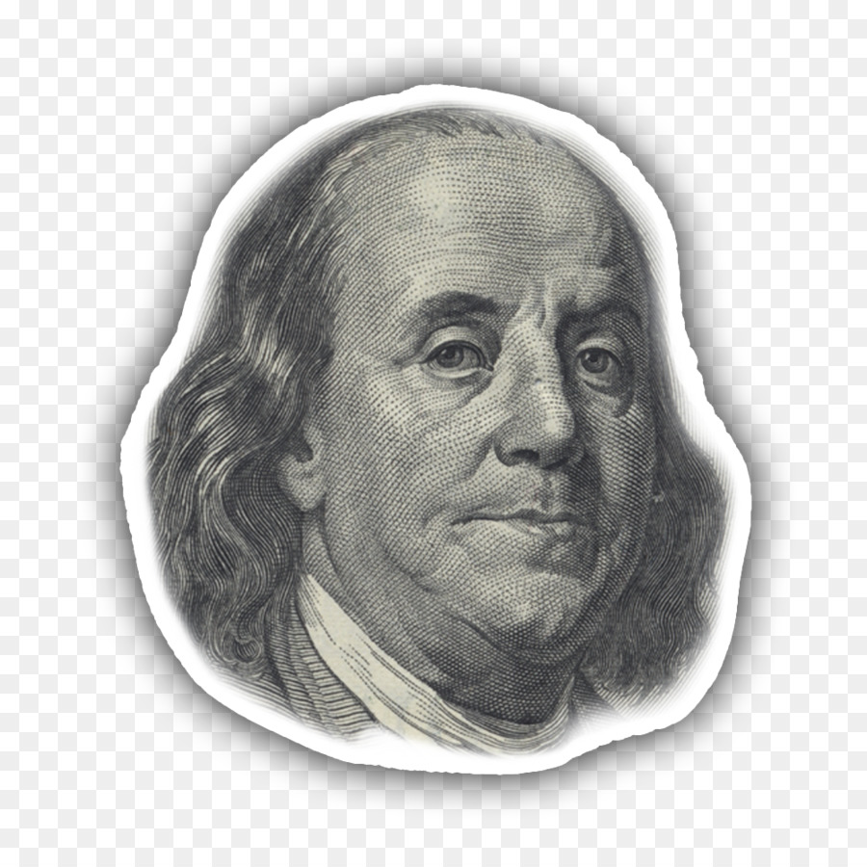

Slide 2
New words

Slide 3
Read the text

Slide 4
Answer the questions

