Slide 1
КИП-119
06.02.2021
Saturday

Slide 2
Learn new words

Slide 3
Read and understand the meaning of the text

Slide 4
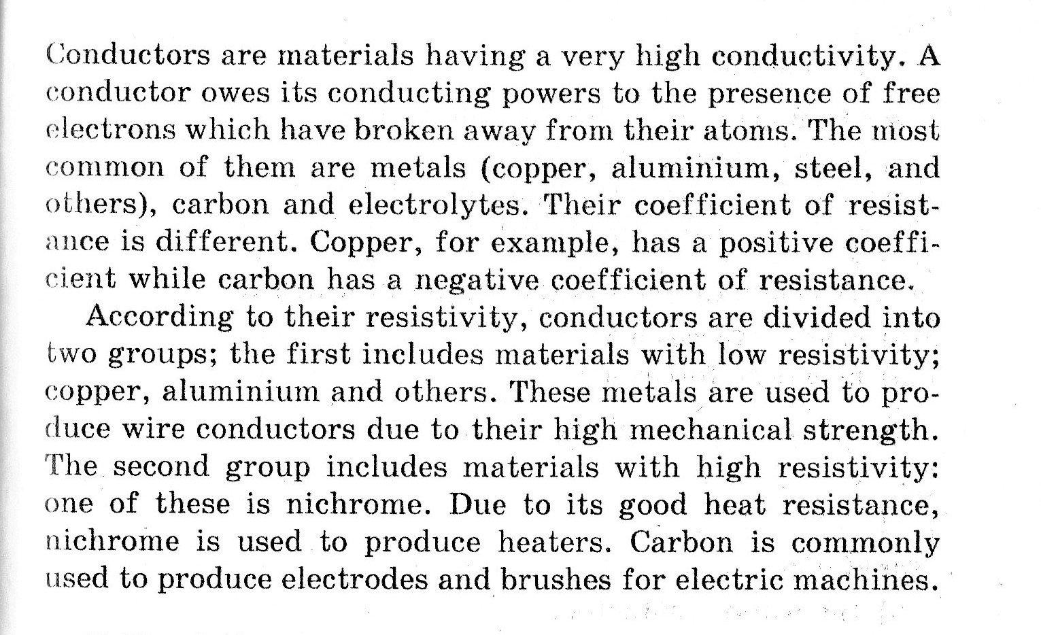

Slide 5
Choose the correct variant
MAGNETISM HAS THE PROPERTY OF ATTRACTING …
GLASS, PAPER;
METALS, IRON
A MAGNET SHOWS THE STRONGEST MAGNETISM AT …
THE NORTH POLE;
THE SOUTH POLE;
THE EQUATOR

Slide 6
A MAGNET …
REPELS ANOTHER MAGNET;
ATTRACTS ANOTHER MAGNET
A MAGNETIS FIELD IS THE REGION IN WHICH …
ELECTRIC FORCES ACT;
MAGNETIC FORCES ACT

Slide 7
GLASS, PAPER, RUBBER ARE …
CONDUCTORS;
INSULATORS.
COPPER IS …
THE WORST CONDUCTOR;
THE BEST CONDUCTOR.

Slide 8
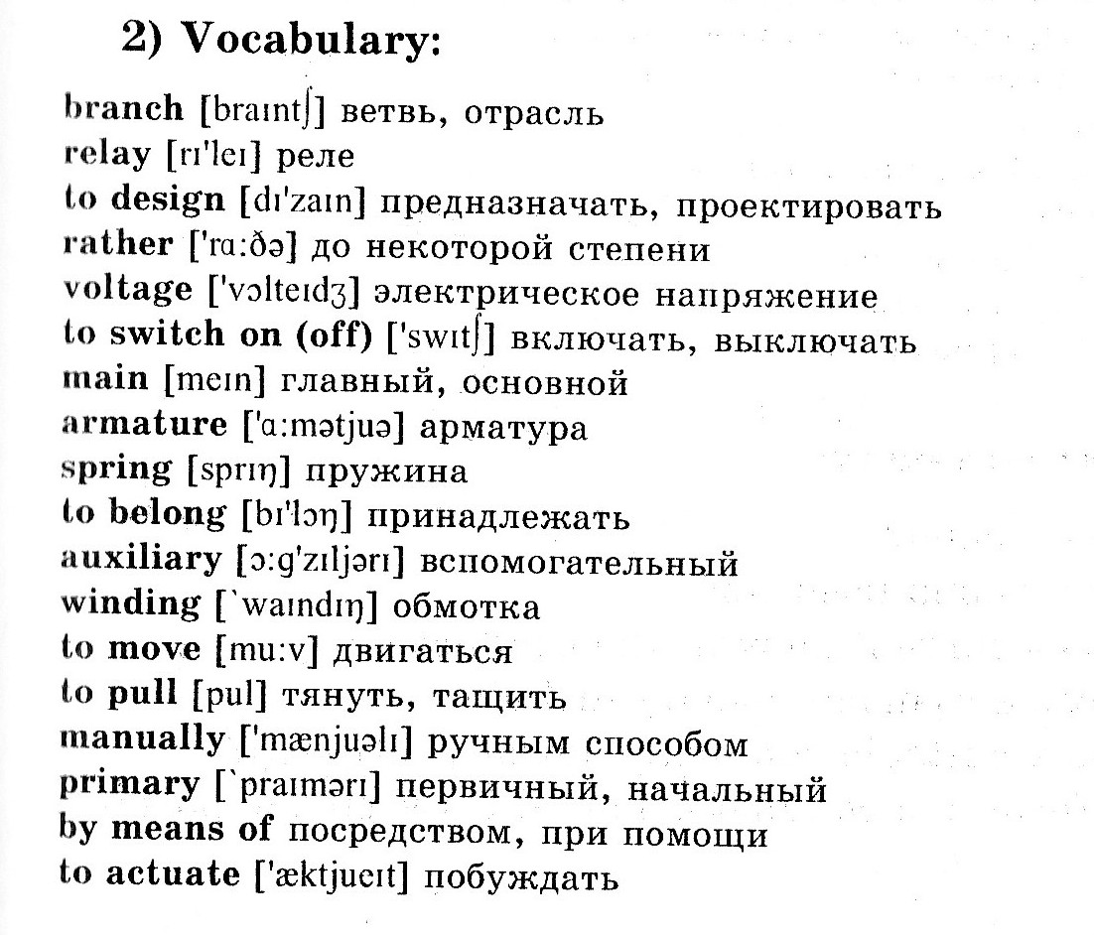

Slide 9
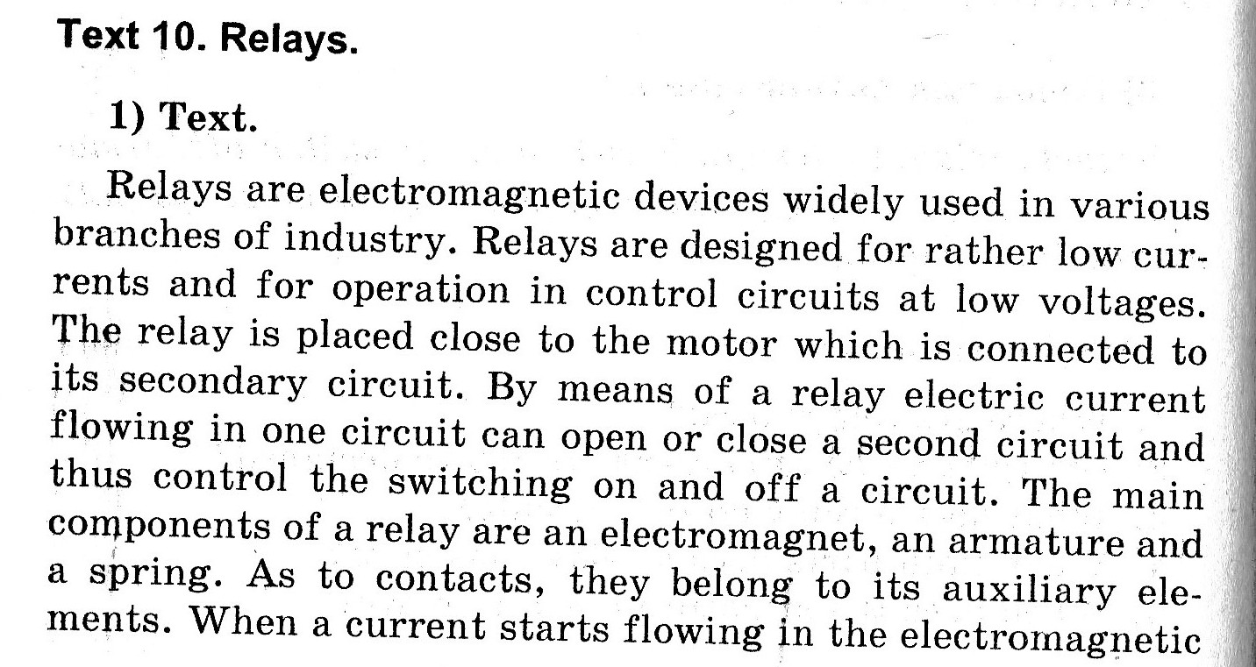

Slide 10
Answer the questions
Where are relays used?
What does a relay do in a circuit?
When does the armature begin to move?
When does the spring close the contact?
What happens to the contacts when there is no current in the primary circuit?
How is the primary circuit opened?

Slide 11
Home task
Make a test КИП-119 20.03.2021 “Relays”
http://до.нттт.рф/mod/quiz/view.php?id=9687

