Slide 1
Series and parallel circuit
May, the 15th, 2021

Slide 3
Vocabulary

Slide 4
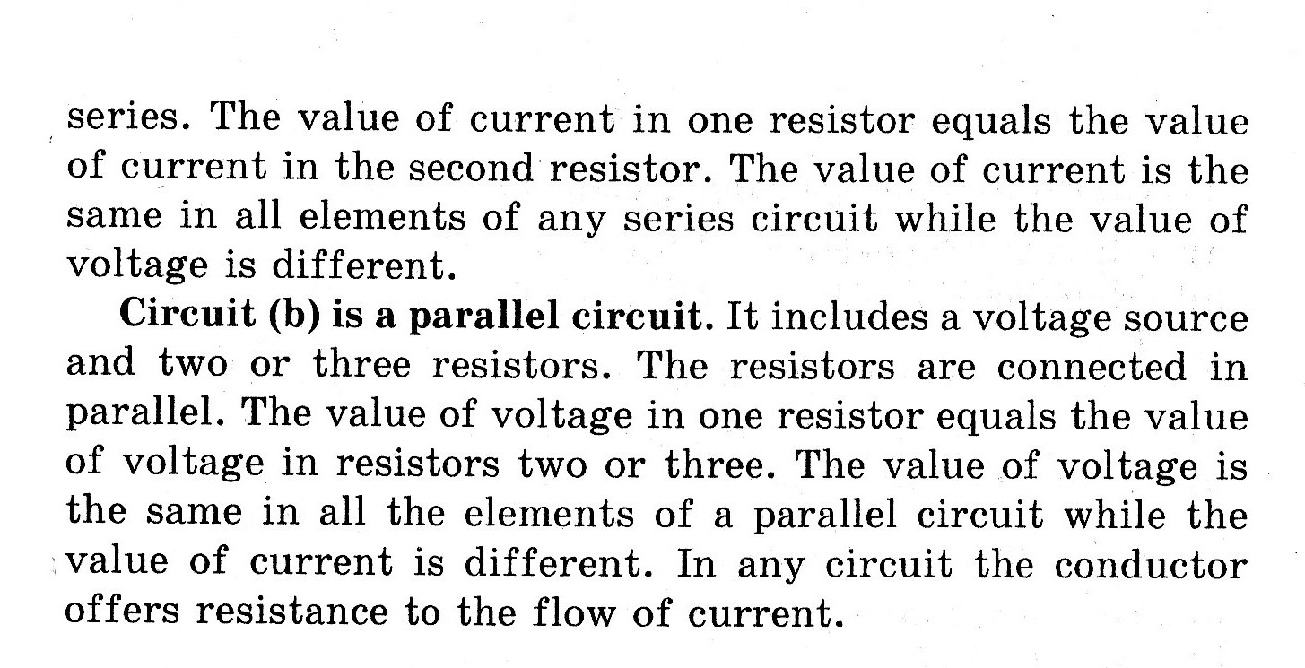

Slide 5
Answer the questions

