Slide 1
Safety first
КИПиА

Slide 2
Safety signs

Slide 3
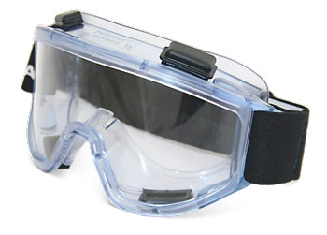
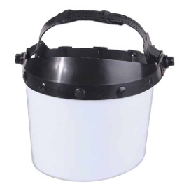
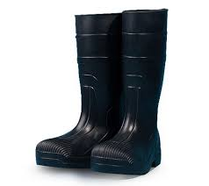
Name the objects

Slide 4
Match the signs with the descriptions given below

Slide 8
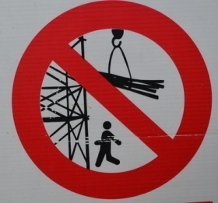

Slide 11
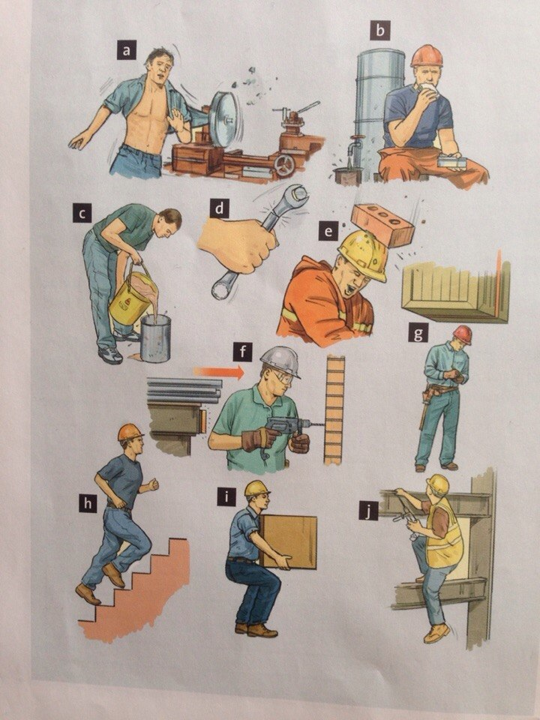

Slide 12
What employers must do for you ?
All workers have a right to work in places where risks to their health and safety are properly controlled. Your employer is responsible for health and safety, but you must help.

Slide 13
What employers must do for you ?
Decide what could harm you in your job and the precautions to stop it.
In a way you can understand, explain how risks will be controlled and tell you who is responsible for this.
Consult and work with you and your health and safety representatives in protecting everyone from harm in the workplace.

Slide 14
Free of charge, give you the health and safety training you need to do your job.
Free of charge, provide you with any equipment and protective clothing you need, and ensure it is properly looked after.
Provide toilets, washing facilities and drinking water. Provide adequate first-aid facilities.

Slide 15
Have insurance that covers you in case you get hurt at work or ill through work. Display a hard copy or electronic copy of the current insurance certificate where you can easily read it.
Work with any other employers or contractors sharing the workplace or providing employees (such as agency workers), so that everyone’s health and safety is protected.

Slide 16
Home work
What you as workers must do? Write about your duties

