Slide 1
PRESENT PERFECT TENSE
Настоящее совершённое время

Slide 2
Past Simple употребляется
когда мы говорим о действиях, которые произошли в прошлом и с настоящим моментом не связаны, мы обычно знаем когда, а часто и где эти события произошли.
e.g. Yesterday I visited my friend.
Last summer we went to London.

Slide 3
Present Perfect употребляется:
если неизвестно или неважно, когда совершено какое-либо действие, но важен его результат.
e.g. We have cleaned the house. The house is clean now. (Неважно, когда мы убрали дом, главное, что он чистый.)
e.g. What have you done this month?
We have helped elderly people this month.

Slide 4
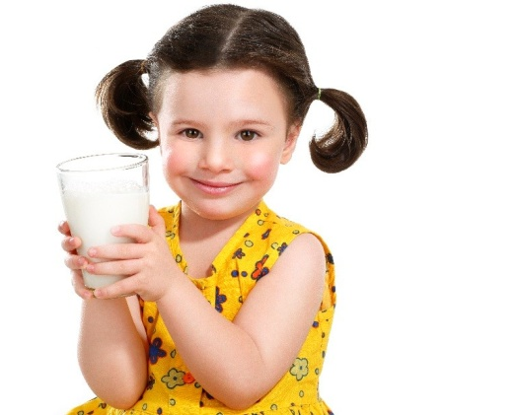
Маркеры времени Present Perfect
just – только что
already – уже
never – никогда
ever – когда-либо
yet - ещё
Обычно они ставятся перед V3
e.g. I have just drunk milk.
She has already flown to America.
He has never flown to Africa.

Slide 5
Исключение
yet - ещё
ставится в конце предложения
e.g. We haven’t been to Mexico yet.
В современном английском языке yet часто используется в вопросах, заменяя наречие already, которое обычно встречается в утвердительных предложениях.
e.g. He has already spoken at the meeting.
Has he spoken at the meeting yet?

Slide 6
Образование Present Perfect
I
You He
We V3 She V3
They It
e.g. I have washed the dishes.
He has eaten fruit.
have
has

Slide 7
Negation in Present Perfect
I He
You not V3 She not V3
We It
They
e.g. I have not washed the dishes.
He has not been to Spain.
have
has

Slide 8
Questions and short answers in Present Perfect
I
you he
we V3 ? she V3 ?
they it
e.g. Have you washed your hands?
Yes,I have. No, I have not (haven’t)
Has Hellen been to Moscow?
Yes, she has. No, she has not (has’t)
Have
Has

Slide 9
3 форма английских глаголов (V3)
Правильные глаголы Неправильные глаголы
V+ ed см.таблицу неправ.гл.
to work – worked to be – been
to wash – washed to come –come
to help – helped to see – seen
to play –played to do - done
to visit – visited to forget - forgotten
to clean – cleaned to write - written

Slide 10
Choose the correct form of the verb to have
I ... fed my dog.
She ... eaten the cake.
Mike ... done his homework.
The ... broken the window.
The boy ... hurt his hand.
My mother ... forgotten her key at home.
Children ... drunk the lemonade.

Slide 11
Answer the questions:
Have you ever been to France?
Have you done your homework yet?
Have you helped your parents today?
Have you seen this film?
How long have you played the piano?
What have you done this week?
How have you helped your school?

Slide 12
Complete the sentences. Use the Present Perfect
Susan (to make) a new dress for her bithday.
She not (to speak) yet.
We (to learn) already a lot of English words.
I already (to do) my homework. Now I can go for a walk.
He just (to come) home.
I (not yet to eat) today.
The rain (to stop) and the sun is shining in the sky again.

Slide 13
Choose the correct form of the verb.
They _______the company two years ago.
a) started b) have started
I _________them since December.
a) didn’t see b) haven’t seen
He ______a new car two weeks ago.
a) bought b) has bought
We ______back on Monday afternoon.
a) arrived b) have arrived
They already ________the problem.
a) solved b) have solved
It _______a lot last winter.
a) snowed b)has snowed

Slide 14
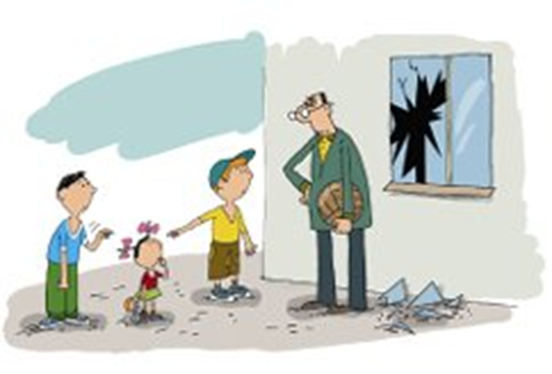
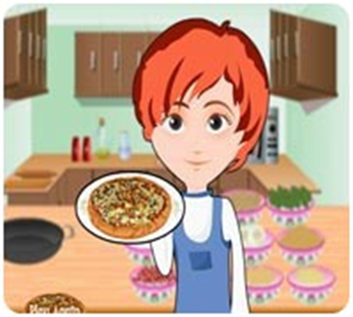
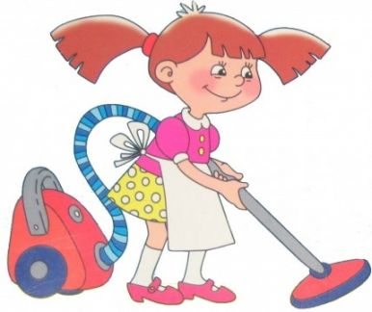
Look at the pictures.What have they done?
2
1
3
4
5
6

Slide 15
Home task
Make up 10 sentences using Present Perfect Tense.

Slide 16
The lesson is over. Thank you for your work. Good – bye!

