Slide 1
Plurals of NOUNS

Slide 2
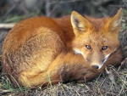
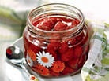
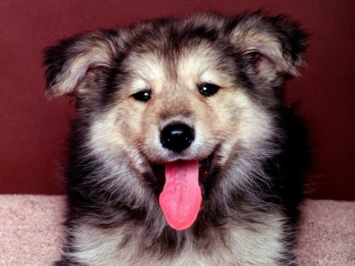
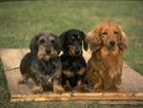
NOUNS
COUNTABLE
UNCOUNTABLE
SINGULAR
PLURAL

Slide 3
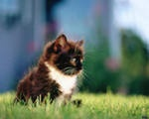
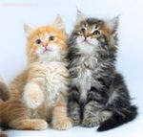
Most nouns form their plural by adding -s
One cat
Two cats

Slide 4
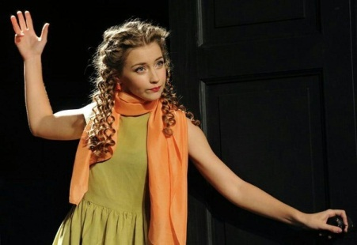
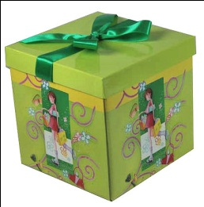
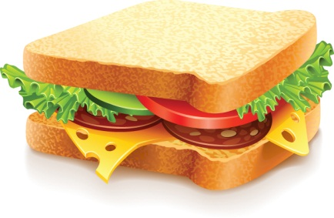
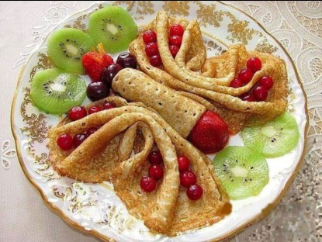
Nouns ending in – s, ss, x, sh, ch take – es in the plural
Sandwich - sandwiches
Actress - actresses
Box - boxes
Bus - buses
Dish - dishes

Slide 5
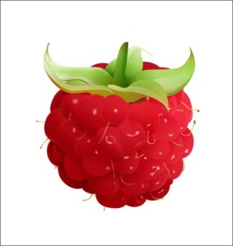
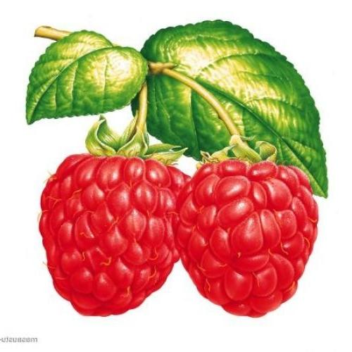
Nouns ending in a consonant +y, drop the
-y and take -ies in the plural
two raspberries
a raspberry
a baby-babies
a lady-ladies
a cherry-cherries

Slide 6
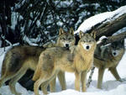
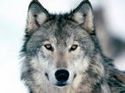
Nouns ending in -f or -ef, drop -f or -ef and take -ves in plural
three wolves
a wolf
(крыша) roof-roofs
giraffe-giraffes
BUT some nouns ending in -f or -ef
take only -s

Slide 7
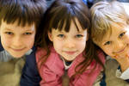
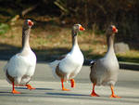
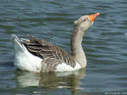
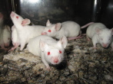
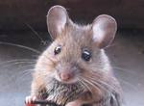
Irregular Nouns
a child- children
a man – men
a woman-women
a goose-geese
a tooth- teeth
a foot- feet
an ox- oxen
a mouse- mice
a sheep-sheep
a person – people
a deer - deer

Slide 8
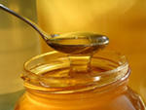
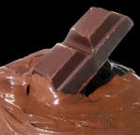
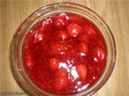
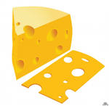
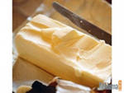
UNCOUNTABLE NOUNS
cheese, butter, meat, salt, pepper, bacon, bread, chocolate, honey, jam, etc.
food

Slide 9
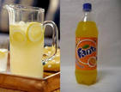
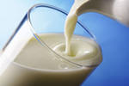
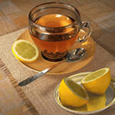
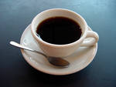
liquids
coffee, milk, water, tea, wine, lemonade, petrol, oil, etc.

Slide 10
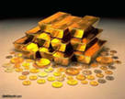
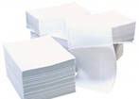
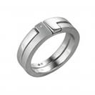
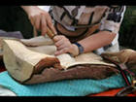
materials
gold, iron, silver, wood, paper, etc.

Slide 11
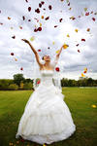
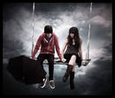
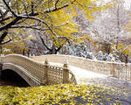
abstract nouns
beauty, love, happiness, etc.

Slide 12
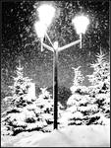
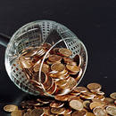
hair, money, news, advice, snow, furniture, weather, etc.
others

Slide 13
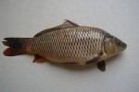
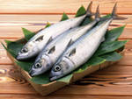
Some uncountable nouns become countable with numerals before them
REMEMBER
hair
BUT: two hairs
fish
BUT: three fishes

Slide 14
Check Yourself
Copy the nouns and translate
To write, music, to play,a child, a family, weather, to walk, to sit , honey, hair, paper, a giraffe, a baby, to do, an orange, a cherry.

Slide 15
Check Yourself
Put the nouns in 2 groups: countable/ uncountable .
cheese, chocolate, lemon, ball, desk, photo, toy, mouse, man, child, woman, room, fox, bus, sheep, milk, love, piano, fork, money, snow, cat, jam, butter, gold, beauty, tooth, lady.
Countable nouns | Uncountable nouns
Lemon Ball Desk Photo Toy Mouse Man Child Woman Room Fox Bus Sheep piano Fork cat Tooth lady | Cheese Chocolate Milk Love Money Snow Jam Butter Gold Beauty

Slide 16
Check Yourself
Write the countable nouns in plural form
Lemon - lemons Ball - balls
Desk - desks Photo - photos
Toy - toys Mouse - mice
Man - men Child - children
Woman - women Room - rooms
Fox - foxes Bus - buses
Sheep - sheep piano - pianos
Fork - forks cat - cats
Tooth - teeth lady - ladies

Slide 17
Check Yourself
Write irregular nouns in plural form
person, businesswoman, foot, ox, deer,fish, goose.

