Slide 1
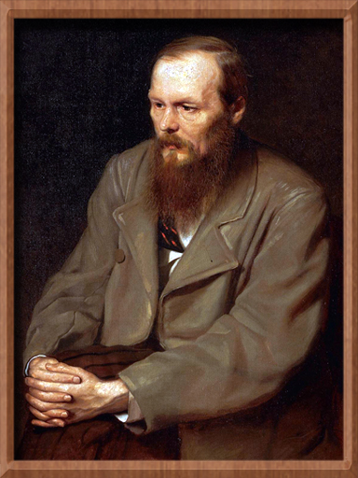
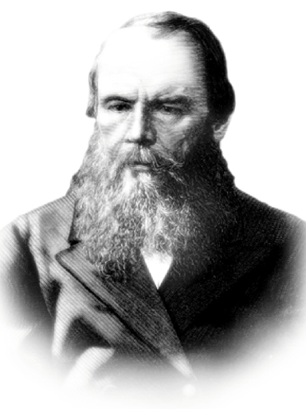
Fyodor Mikhaylovich Dostoevsky
Great Russian writer and thinker
(1821 – 1881)
His signature:

Slide 2
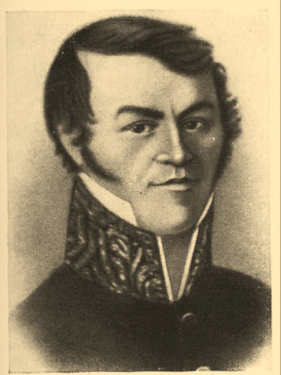
Family
Father
Mikhael Adreevich was a doctor of Moscow hospital for poor, he was a hereditary nobleman. In 1831 he received two villages. He was rather educated, independent and very suspicious. In 1837, after his wife’s death, he retired. According to many documents, he was killed by peasants.

Slide 3
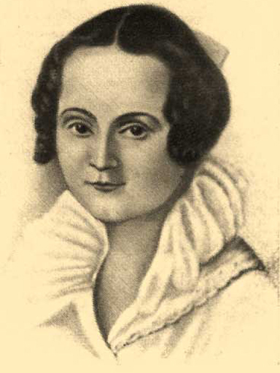
Family
Mother
Maria Fedorovna (Nechaeva by birth) was a very nice and kind woman. She died in 1815 from consumption (чахотка).
There were six children in Dostoevsky’s family: Varvara, Andrey, Vera, Nikolai, Mihael, Alexander.

Slide 4
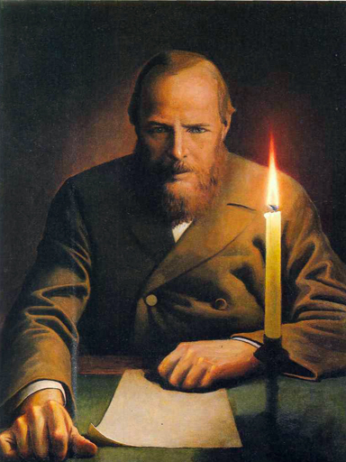
The writer’s life
In 1833 Dostoevsky was given together with his brother to a boarding- school. The teacher of the Russian language – Bilevich played a certain role in the spiritual life of a writer. Remembrances about boarding school served as a material for a lot of his literary works.

Slide 5
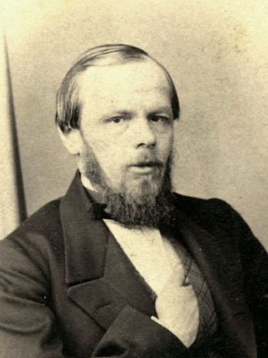
The writer’s life
1837 - was very important for a writer. It was the year of his mother’s death, Pushkin died in 1837, he liked his literary works. That year he went to Petersburg and entered the engineering college, where he got a good engineering education and a good opportunity to go on with his cultural development.

Slide 6
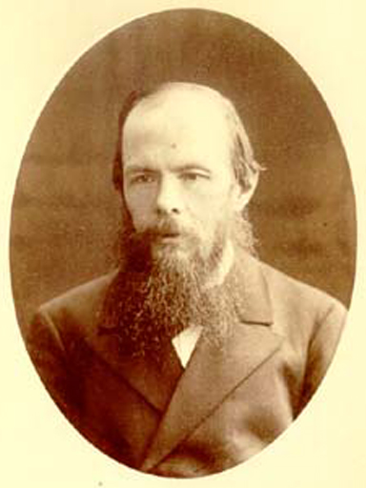
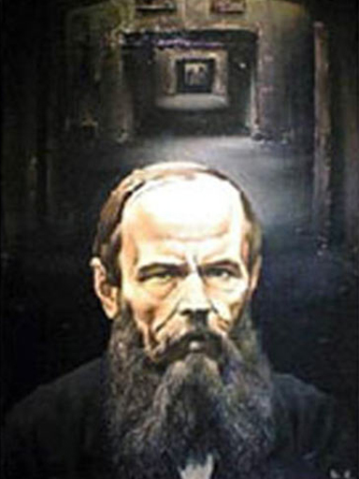
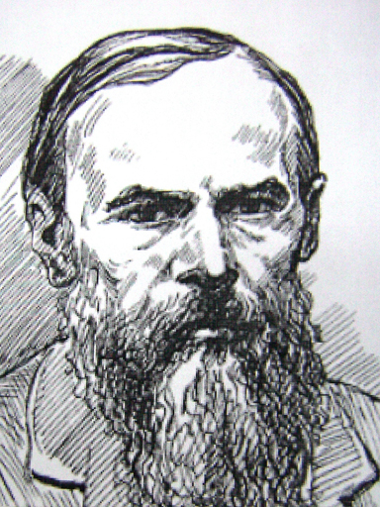
The writer’s life
In 1839 he got the information about his father’s death.
He was killed by serf peasants. Later, he met Shidlovsky. He was fascinated by his romantic and religious moods.

Slide 7
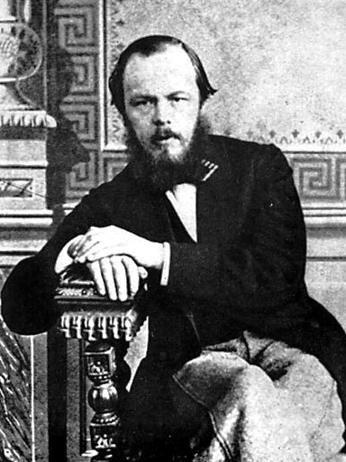
The writer’s life
In 1849 he was arrested because of his revolutionary views. He was a member of Petrashevsky Circle. Later, he was sent to a hard labour to Siberia. Here he fell in love with Maria Isaeva. In 1857 they got married.

Slide 8
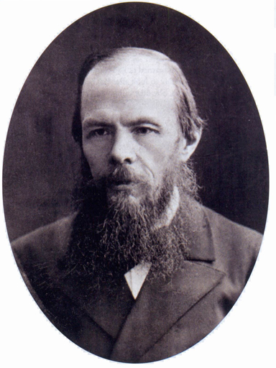
Political views
There were two political views in cultural layers of society: “ slavyanofilstvo” and “ zapadnichestvo”. But Dostoevsky had his own idea” “ pochvennichestvo”. After having been abroad, he became a monarchist.

Slide 9
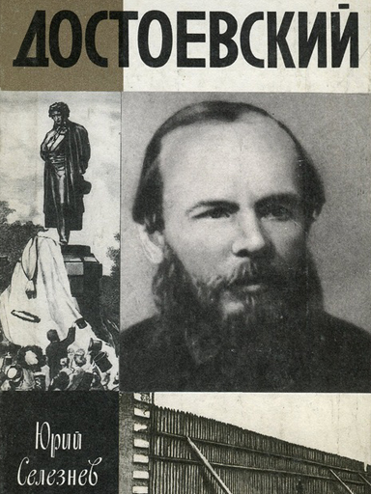
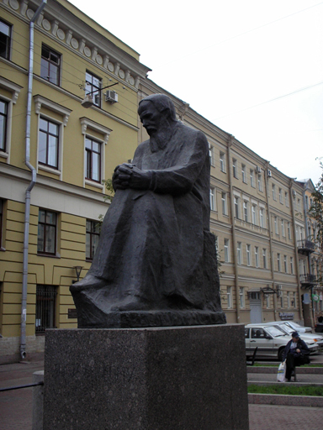
Creativity
His creativity made a great influence on Russian and world literature. His literary heritage is valued in different ways in Russia and abroad.

Slide 10
Aphorisms
Beauty will save the world;
Life is suffocating without purpose;
Fool, confessed that he is a fool is not a fool;
Money is stamped freedom;
A cheerful man is an outstanding feature of the person;
Poverty is not a Vice.

