Slide 1
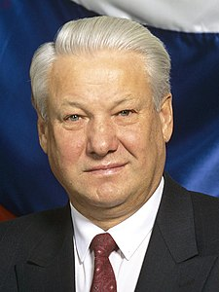
Boris Nikolaevich Yeltsin

Slide 2
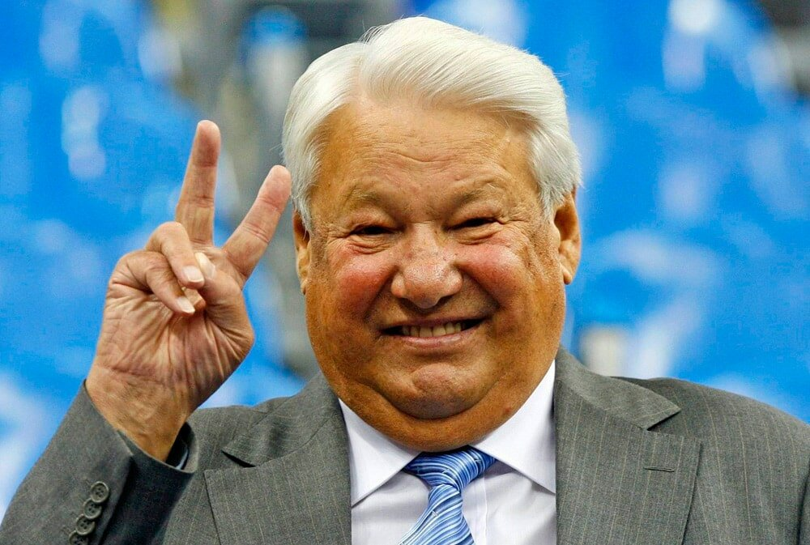
Born on February 1, 1931 in the Ural region.
He died on April 23, 2007 in Moscow.

Slide 3
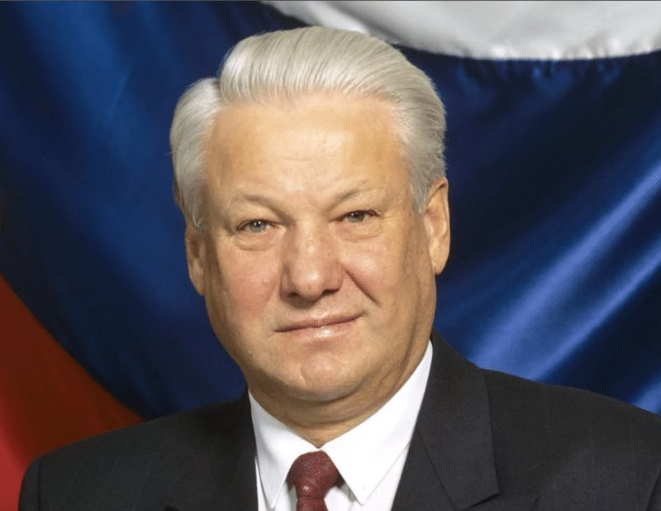
He was the first President of the Russian Federation from 1991 to 1999

Slide 4
Mother – Claudia Vasilyevna Yeltsina (1908-1993), from the peasants, a dressmaker.
Father – Nikolai Ignatievich Yeltsin (June 27, 1906-may 30, 1977), a Builder.

Slide 5
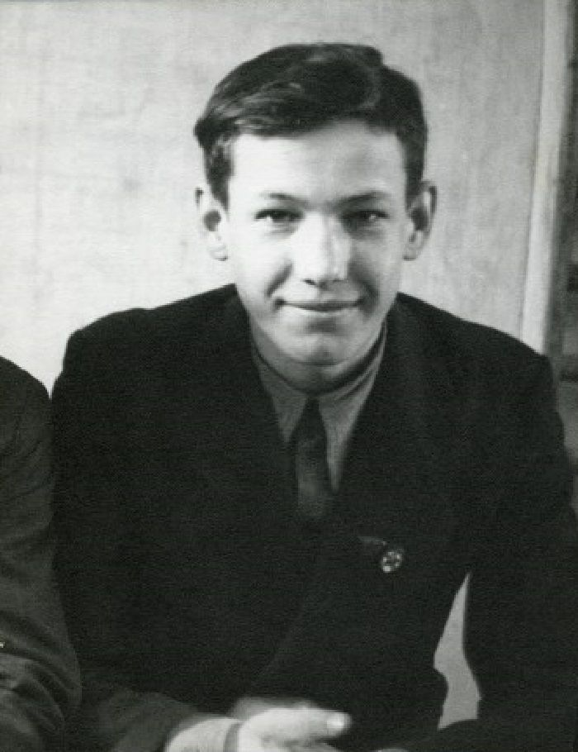
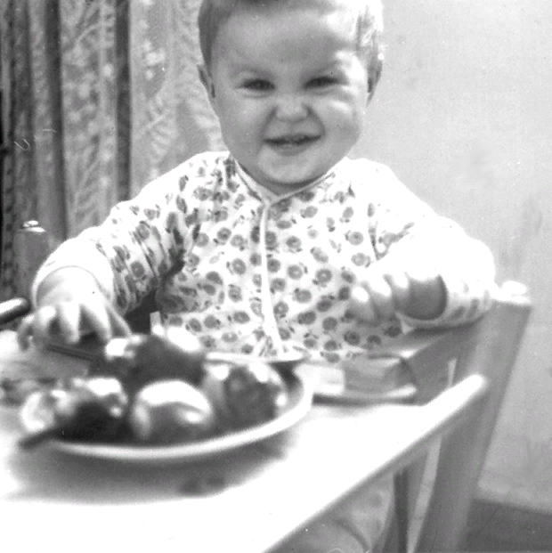
Yeltsin spent his childhood in the city of Berezniki, Perm region, where he graduated from school.

Slide 6
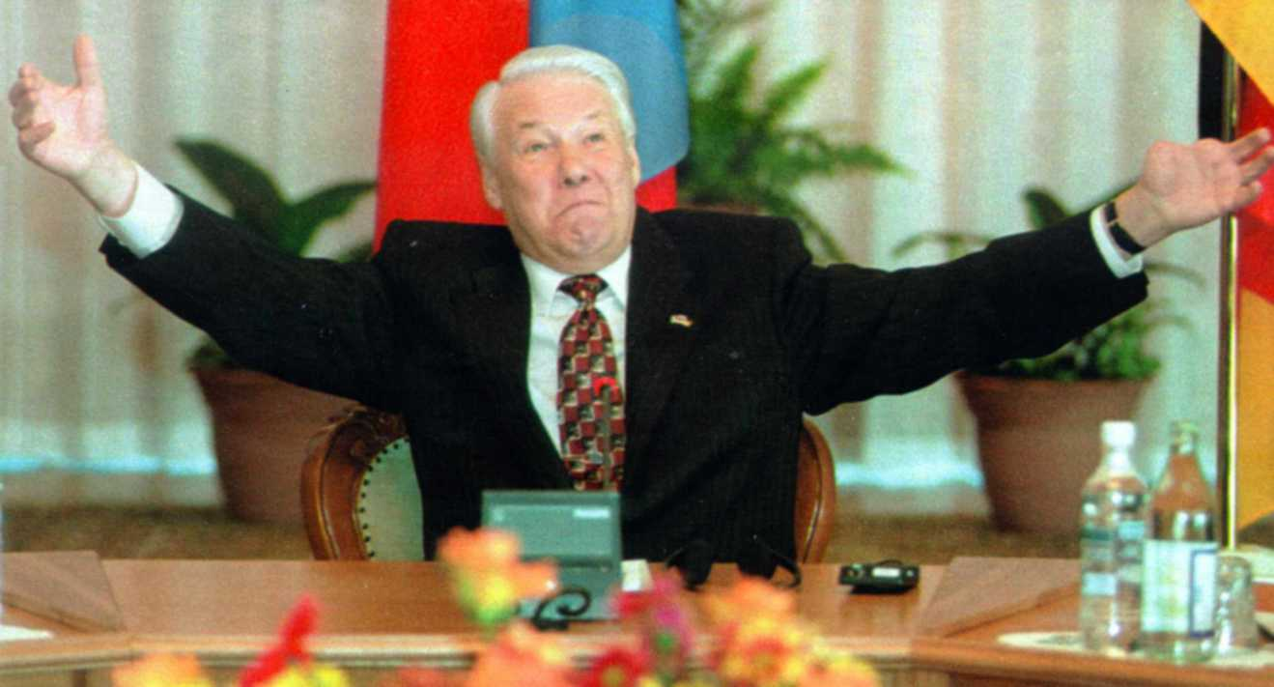
Yeltsin's left hand was missing two fingers and the phalanx of the third. He lost them in the explosion of a grenade that he was trying to open.

Slide 7
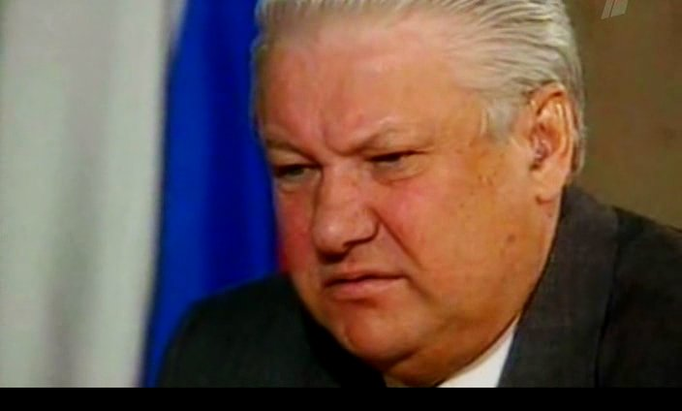
Boris Yeltsin died on April 23, 2007 at 15: 45 Moscow time in the Central clinical hospital as a result of cardiac arrest

Slide 8
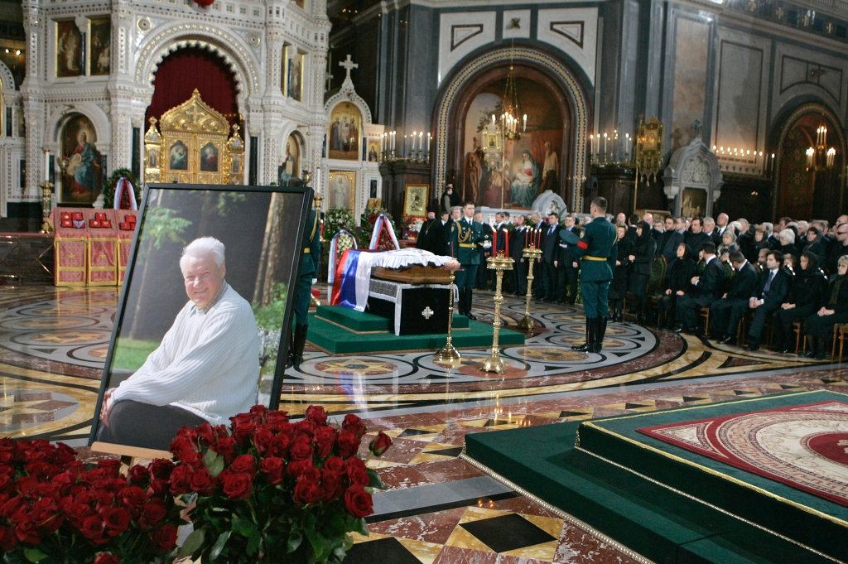
Boris Yeltsin was buried in the Cathedral of Christ the Saviour, which was open all night from 24 to 25 April so that everyone could say goodbye to the former President of Russia.

Slide 9
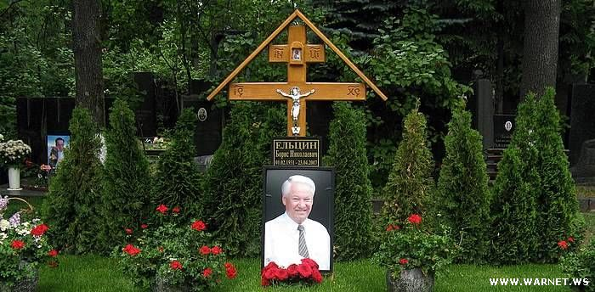
Yeltsin was buried on April 25 at Novodevichy cemetery with military honors. The funeral was broadcast live on all state channels.

Slide 10
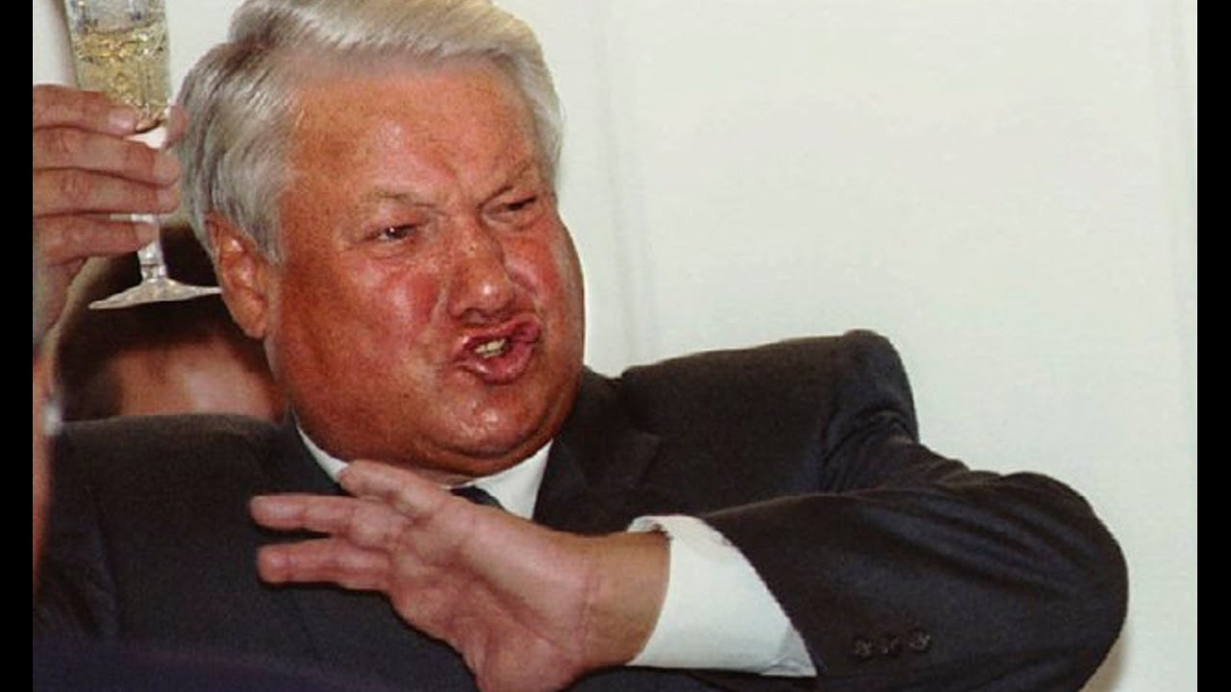
Thanks for your attention!

